Slide 1
Anime Recommender System
By: Annette van Aarde
Date: 6 May 2025

Slide 2
Project Overview
Problem Statement: Build a collaborative and content-based recommender system for a collection of anime titles, capable of accurately predicting how a user will rate an anime title they have not yet viewed, based on their historical preferences.
Objective: Predict ratings for unseen anime using hybrid recommender system

Slide 3
Data Description
anime.csv: 7 columns
train.csv: 3 columns, 7M+ ratings
test.csv: For prediction
submission.csv: Output format

Slide 4
Data Cleaning
Removed -1 ratings
Handled missing values
Merged datasets
Created ID (user_id + "_" + anime_id)

Slide 5
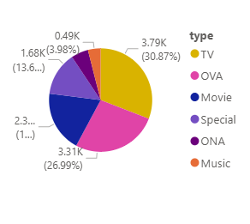
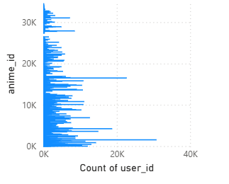
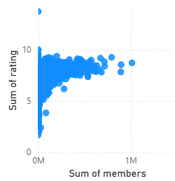
Exploratory Data Analysis
Popular Genre | Top Rated Anime | Distribution of Ratings

Slide 6
Modelling Approach
Collaborative Filtering: User-item matrix + cosine similarity
Final Hybrid: Weighted average of both predictions

Slide 7
Evaluation
Train/Test split
Metric: RMSE
Final RMSE Score (e.g., 1.04)

Slide 8
Key Trends and Insights
High-Rated Anime Are Typically TV Shows or Movies.TV shows tend to dominate top ratings and member counts, likely due to broader viewership and longer engagement.\
Most Rated Anime Are Not Always the Highest Rated. Popularity (measured by number of ratings or members) doesn’t always correlate with higher average ratings.
Genre Diversity Plays a Key Role in User Preference. Genres like "Action", "Drama", and "Comedy" appear most frequently in high-rated and frequently rated titles.
User Behavior Is Highly Personalized. Collaborative filtering (initial attempt using surprise) was skipped due to dependency issues, but content-based filtering still captured meaningful patterns in user preferences.

